Slide 1
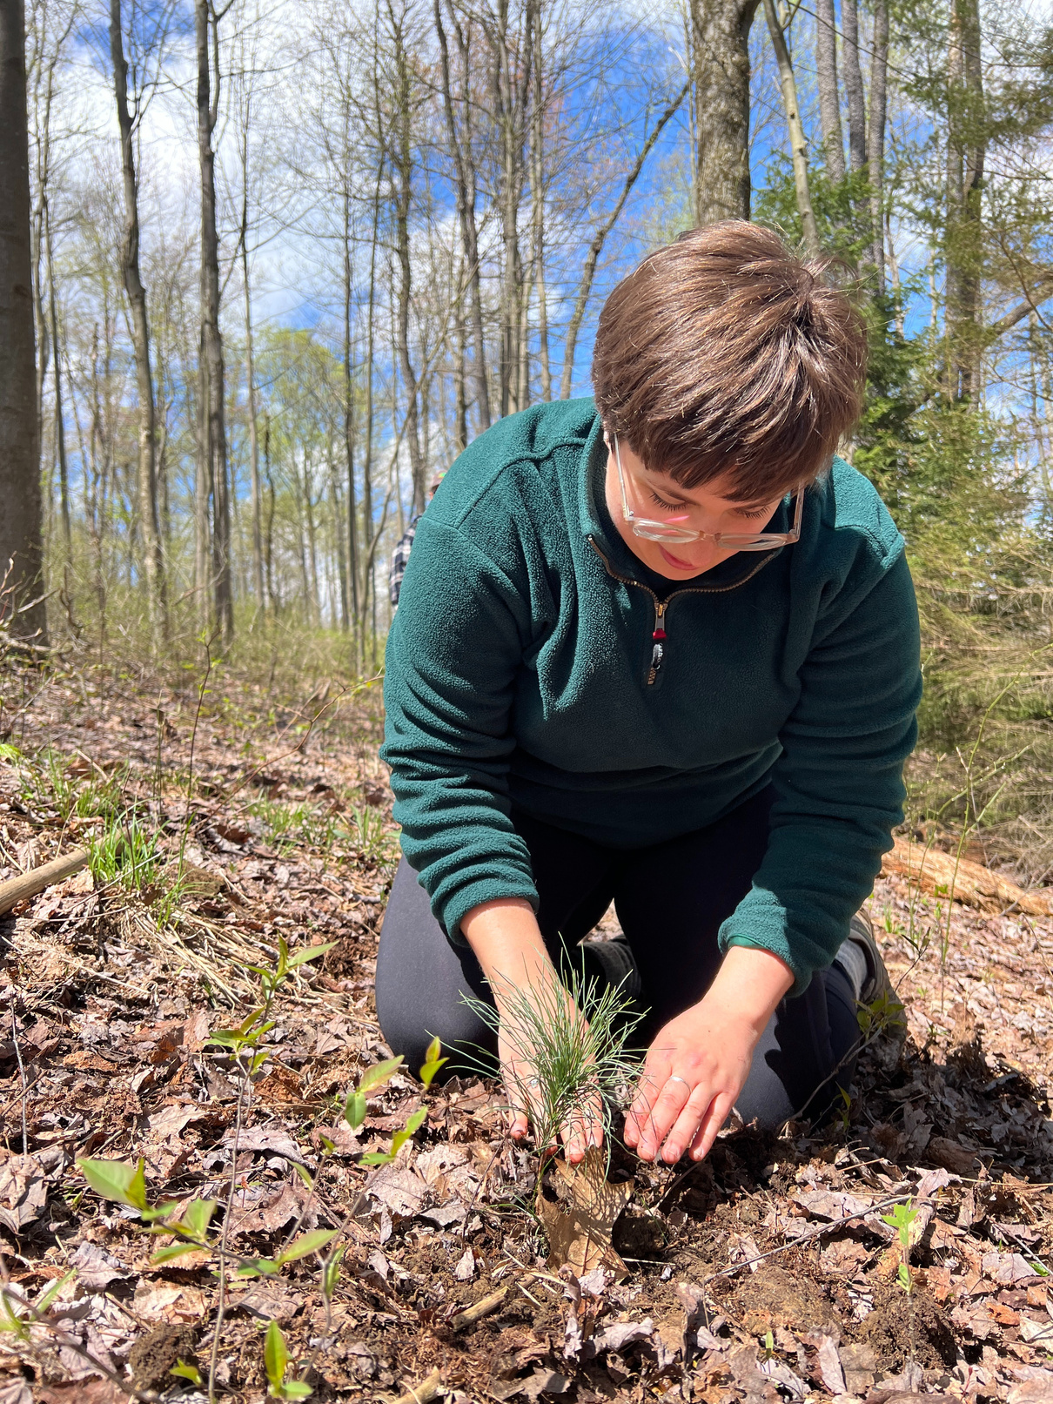
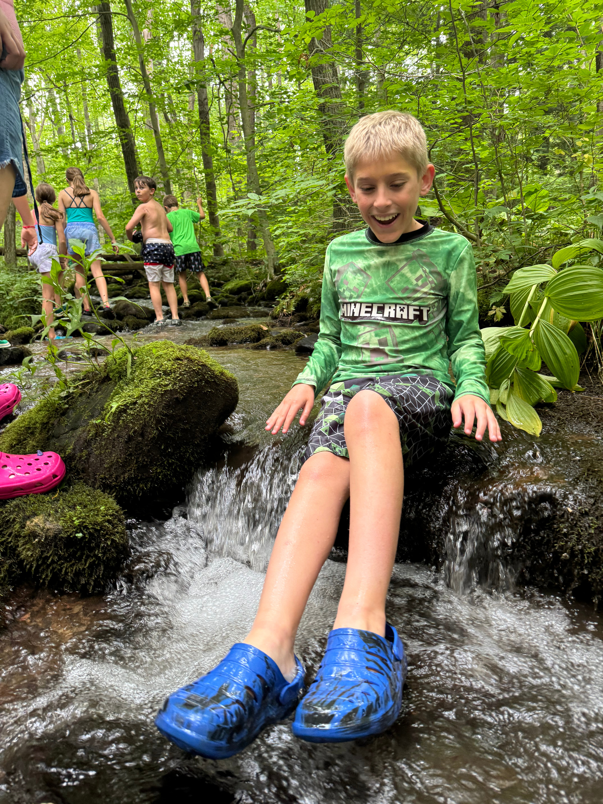



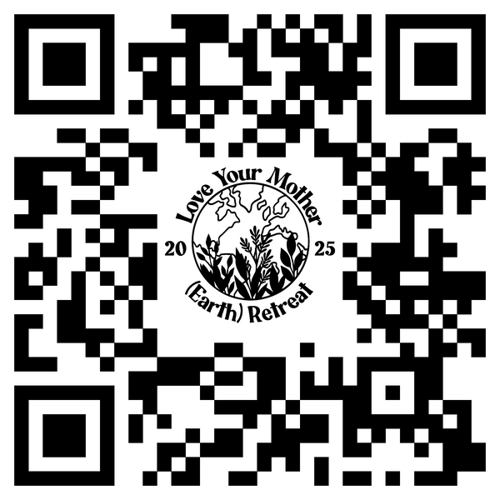
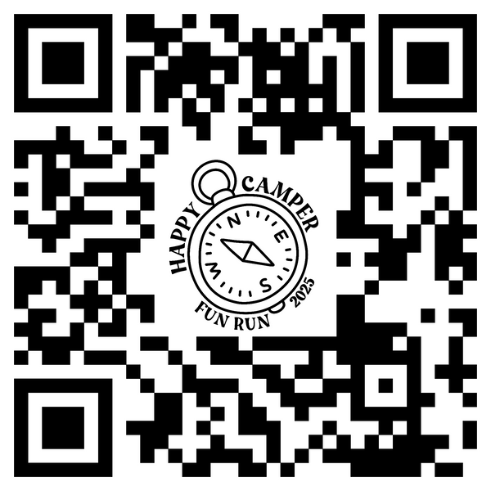
APRIL 26-27
CAMPER
HAPPY
20
25
(Earth) Retreat
2025
FUN RUN
Retreat
Sign Up
Join us this Earth Day weekend as we come together to celebrate and protect our planet. Whether you’re planting trees at camp or learning how to be more sustainable, your actions matter!
Fun Run
Registration
Step outside Saturday, April 26 and connect with nature for the 5th Annual Happy Camper Fun Run! Proceeds benefit camper scholarships.

